Slide 1

Home security and door control using rapid face detection method
Aditya Srinivas B - 122003016
Heshwa B - 122003091
Kkrish N A - 122003120
Guide
Dr. A. Suganya
Asst. Professor – II, CSE / SoC

Slide 2

Base Paper
Title: A fast face detection method via convolutional neural network
Year: 2019
Journal - Neurocomputing
Indexing - SCI
Publisher - Elsevier
Base paper URL: https://www.sciencedirect.com/science/article/abs/pii/S0925231219309075

Slide 3
Abstract
The detection speed is still the biggest bottleneck, which hinders the practical deployment of these face detectors on resource-limited platforms and can’t be used effectively in real-time applications.
Products nowadays require a faster response from the sensors to prevent something worse to happen.
Since many thefts have been happening, the security of homes is becoming vulnerable every day. To secure us from this, a camera can be fitted in the door’s peephole to detect and monitor according to users need.
If any movements of a person are detected in front of the door, it alerts the user and streams the live video, if the user requests.
Simultaneously this face detection model detects the face, captures a snap of their face and sends it to the user’s application. Then the user can take action from remote, whether to allow the person or not.

Slide 4
Literature survey
Title | Work | Method | Year
Face detection using deep learning: An improved faster RCNN approach | A new face detection scheme using deep learning and achieve a good detection performance on the well-known FDDB face detection benchmark evaluation. | Improved by combining many strategies including feature concatenation, hard negative mining, multi-scale training, model pre-training, and proper calibration of key parameters. | 2018
Face Detection with the Faster R-CNN | Applying the Faster RCNN, which has recently demonstrated impressive results on various object detection benchmarks, to face detection. | By training a Faster R-CNN model on the large scale WIDER face dataset, we report best results on the WIDER test set and also in FDDB benchmarks. | 2017
Access Control and Surveillance in a Smart Home | Two IoT based systems in the context of Smart homes: qToggle for multiple home automation, and MotionEyeOS, a video surveillance OS for single-board computers | Most qToggle Devices are based on ESP8266/ESP8285 chips or on Raspberry Pi boards and smart sensors, while MotionEye uses Raspberry Pi boards. | 2021

Slide 5
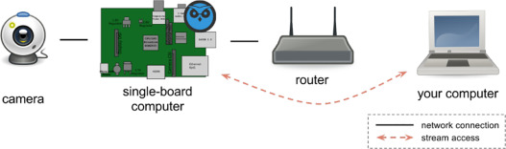
Proposed System
Implement this Face detection model into our home security system.
Whenever a person shows up, this model detects the person’s face sooner.
The detected face is then captured.
The image is then transferred to the user through Raspberry Pi computer via Internet.
The user receives a notification in mobile app.
He/she can control the door’s function to whether allow the person or not.

Slide 6

Methodology

Slide 7

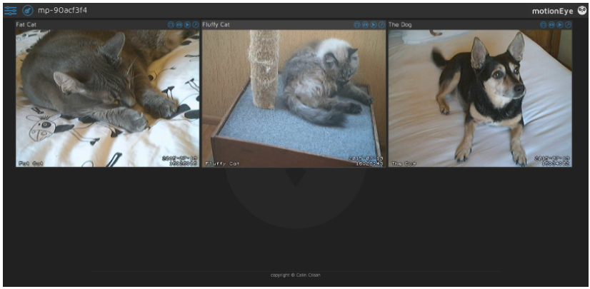

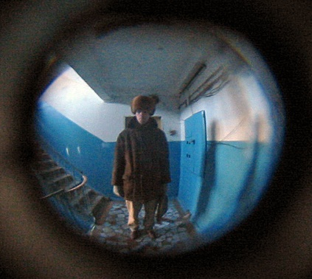

App
Control the door
Live stream / see past detections.
SOS feature
Analyze who are all coming in a timeframe
Face recognition for detected faces (If time permits)
Door 1
Door 2
Door 3

Slide 8

Roadmap

Slide 9
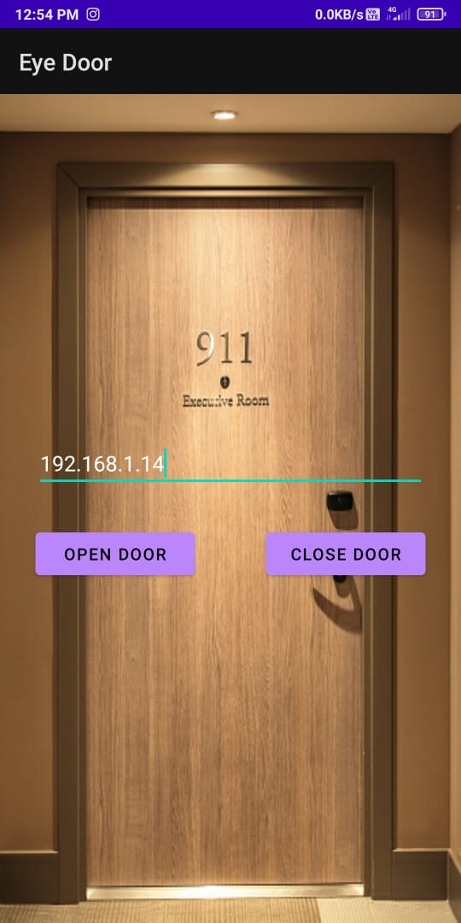
Work carried
RESTful APIs that we made helps to integrate the app and the door-latch.
APIs are hosted in Raspberry Pi server.
Rasp. Pi gets and processes the request
Firebase messaging cloud service are used to send notifications to App.

Slide 10
Future Work Plan
Integration of door-latch mechanism
Improvised door-latch
Face recognition
Notification alert
Adding features in app
Aesthetic UI

Slide 11
Datasets
200 images from - 256_object_categories -> people
100 images from AFW -> Wider -> images -> 1-Handshaking
Different amount of pictures used for training different models

Slide 12
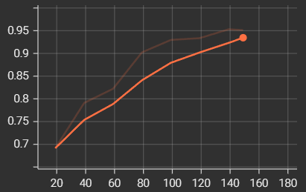
Accuracy
Accuracy : > 95 %
X-axis – No. of iterations
Y-axis - Accuracy

Slide 13
Comparison

Slide 14
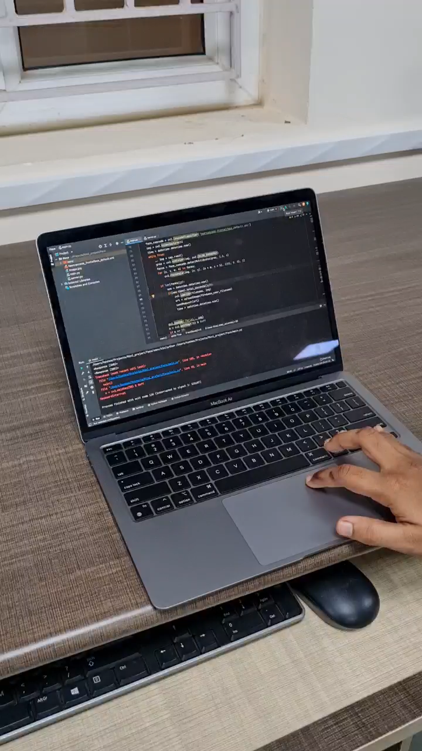
Core functioning
Face detection detects the face
Picture is taken when person steps in front of door
Sent to the user as notification
User uses the app to control the door’s action
Appropriate action is taken by the user.
The action is recorded in history log with the picture
SOS feature can be used when user finds it skeptical

Slide 15
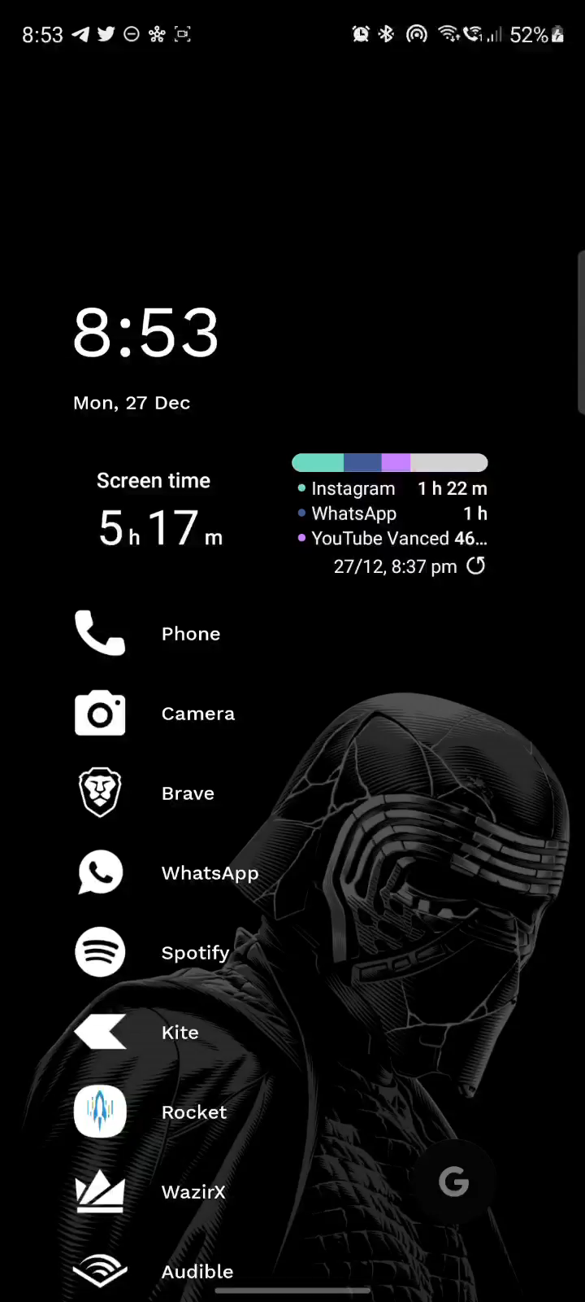
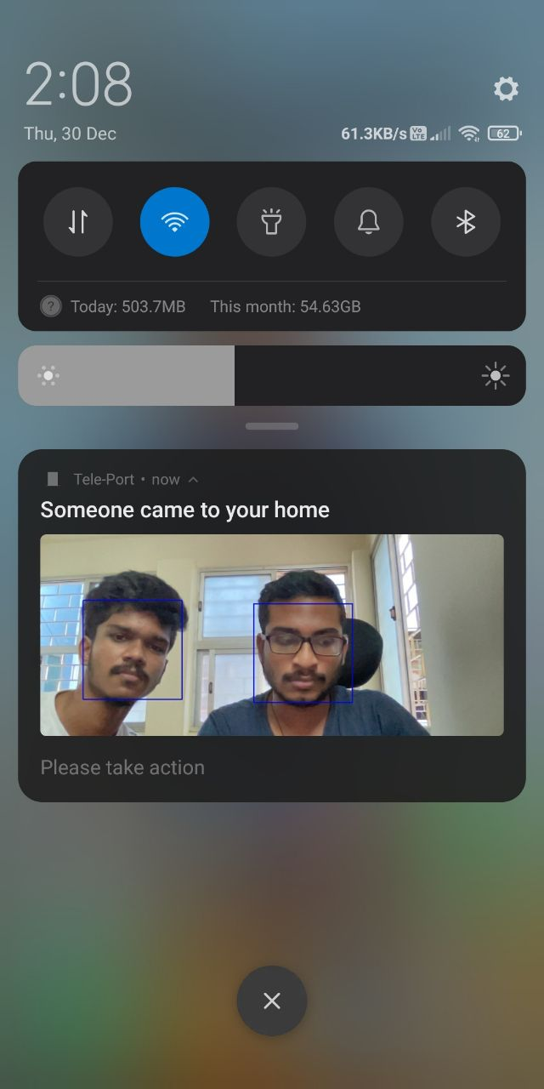
Entire functioning
SOS
Specify Address
Add many doors
Notifications
Emergency contact
History

Slide 16
References
H. Jiang, E.G. Learned-Miller, Face detection with the faster R-CNN, CoRRabs/1606.03473 (2016)
R. Girshick, Fast R-CNN, in: Proceedings of the IEEE Conference Computer Vision and Pattern Recognition, 2015, pp. 1440–1448
Cristina Stolojescu-Crisan, Access Control and Surveillance in a Smart Home, (2021), High-Confidence Computing, pp. 100036
Waheb A. Jabbar, Design and Fabrication of Smart Home With Internet of Things Enabled Automation System, in: IEEE Access (Vol: 7), (2019), pp. 144059 – 144074

Slide 17
Thank you !

